Slide 1


Slide 2
Raise Boring, Shaft sinking operation

Slide 3
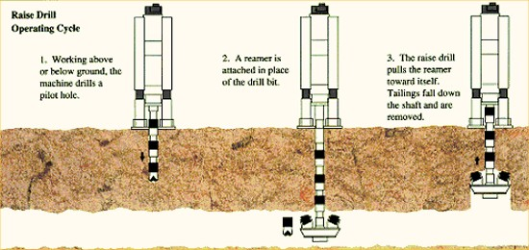
RAISE BORING
Rock conditions and their variability.
Very hard rock, their system is slow.

Slide 4
EQUIPMENTS FOR SOFT ROCK (European coal fields):-
Pilot hole diameter
Drill pipe diameter
Reaming Torque
Type of driver (AC, DC ,hydraulic)gear reducer
RPM
Power: Pilot hole thrust & feed rates reaming pull, size of drill pipe base plate and derrick dimensions, type of transporter, water and air consumption.
Diameter/length/advance per unit time .
Costs reduced due development of improved cutters with average life being extended by fire fold.

Slide 5
Purpose of Raise Boring:-
Ore passes
Ventilation
Ventilation shafts
Full sized shafts for coal mining.

Slide 6
Advantages of Raise Boring:-
No worker needs to be present while excavation is on .
Cost thus gets reduced (in developed countries).
Faster progress.
Less damage to surrounding rock/thus minimum support is needed.
Smooth, stable walls, lead resistance for ventilation.

Slide 7
Disadvantages of Raise Boring:-
Change on rock conditions
Costs are high for hard rocks.
Access necessary.
Initial cost of rig is high.
Shaft should be dry.

Slide 8
Operations :-
The machine drills Pilot hole and then reamer is attached in place of drill bit.
The raise drill pulls the reamer towards itself.
3. Tailings fall down the shaft and are removed.
CLUTCH COMPONENTS:-
Rig – Rigid plate and structure
Hydraulic, drilling and electrical equipment are housed

Slide 9
Crawler Driven by Compressed Air/Railwheels:-
Pilot hole is drilled through the stem with stabilizers and a conventional drilling bit.
Drill rod diameter (20 -31 cm)
Length of the section is 1.5 m.
Purpose of stabilizer is to ensure directional accuracy of the pilot hole .
Stem longest /reamer-stages / structural analysis of required/balancing of tool by positioning cutters optimally.
Geared reamers/conventional type .
Best performance is achieved when cutter life and ROP are optimized.

Slide 10
Structural features- Ductility/Brittle abrasivity.
Removal of cuttings (should be effective )
Reduce rocks layer of cuttings 40%
Drilling –air /water/foam/drilling fluid
D=W
Where D is DOP and W is applied load.
Reaming
RPM – wear/vibrations
Adequate room/interference with production
Drilling down/reaming up is the cheapest option.
Rock quality and its response can change the boring
direction.
Lining – strong rocks no lines/shotcrete/rockbolt /± wire
mesh/steel lining.
Cost

Slide 11
Diameter | Length (move/min) | Mobilization (cost/move/m) | Setup (cost) | Pilot holes | Ream/m
3 m | 600/37 m/min | 58286/4436 Rs-sec/m | 29100/4500 Rs/- | 28/12 | 81/47 m⁻¹

Slide 12
Khetri Shaft Details:-
Adit section : For exploitation of ore body above 424 MRL
Decline section: 5 mX3.25m size ,11N 9 from surface to364MRL and 306 MRL .
Production shaft section:424 MRL
Production Shaft:-
Up cast shaft-5.5 m diameter.
Concrete lined.
Tower mounted 2870 KW 6 rope friction hoist with 2/14 t ships in counter balance.
Emerging escape and c ladder way
Hoisting speed : 2 stages 1)8m/s 2)18 m/s

Slide 13
Service Shaft:-
Rectangular in shape
Size : 6.11m X 4.93m.
2 cage hoisting compartments.
Emergency escape cage & c ladder way.
Double deck cages guided by rigid rail guides.
Shaft is provided with a steel head frame and is1600 cylindrical double drum hoist with one drum cluthed.

Slide 14
ORGANISATION OF SHAFT SINKING:-
Drilling + mucking/hoisting + lining
(shorter holes will take one cycle/shift)
Optimum would be the length that assures
a unit advance with minimum time taken.
Min. Cost principle ( Drilling of holes , explosives, Mucking, Time taken).

Slide 15
Drilling Pattern :-
Accuracy in the shape of excavation.
Clean separation up to the desired depth.
Uniform fragmentation.
Minimum misfires(should be avoided).
Damage is controlled (nearby structures).

Slide 16
Pattern :-
Shape of the section
Rock strength.
Cleavage.
Dip of strata.
Water inflow.
Hole loading structure.

Slide 17
Cartridge | No. Of circles | Diameter of holes | Holes rate
32mm. | 3 | 0.37,0.66,0.93 | 1-2-3
 | 4 | 0.35,0.54,0.7,0.93 | 1-2-3-4
 | 5 | 0.27,0.43,0.6,0.93 | 1-2-3-4-5
45mm. | 3 | 0.3,0.6,0.95 | 1-3-6
 | 4 | 0.25,0.48,0.72,0.96 | 1-2-3-5

Slide 18
LINING IN SHAFTS
Factors:-
Type of lining.
Hydro geological conditions (geotechnical parameters).
Shaft function.
Planned life time.
Shape of shaft section.
Depth.
Availability of construction materials.
Construction cost .
Chemical activity.
Repairs and maintenance .

Slide 19
Temporary lining:-
Against falling rocks (6-40m).
Necessary when tech. is advancing.
Permanent lining:-
Timber
Brick
Concrete blocks
Concrete monolithic
Reinforced concrete
Tubbers (cast iron and pre cast elements)
Shotcrete (with wire mesh)
Anchor bolts (a combination some times)

Slide 20
1.Brick lining:-
Bricking lining was popular/ability to carry load immediately /ease of repairs and resistance to corrosive factors.
2.Concrete block lining:-
Decreased seams
Higher strength
Less labour
Intensive in comparison to brick lining

Slide 21
3.Timber Lining:-
Seldom.
Disadvantage:-
Time and labour consuming
Low strength
High cost
Substantial permeability.

Slide 22
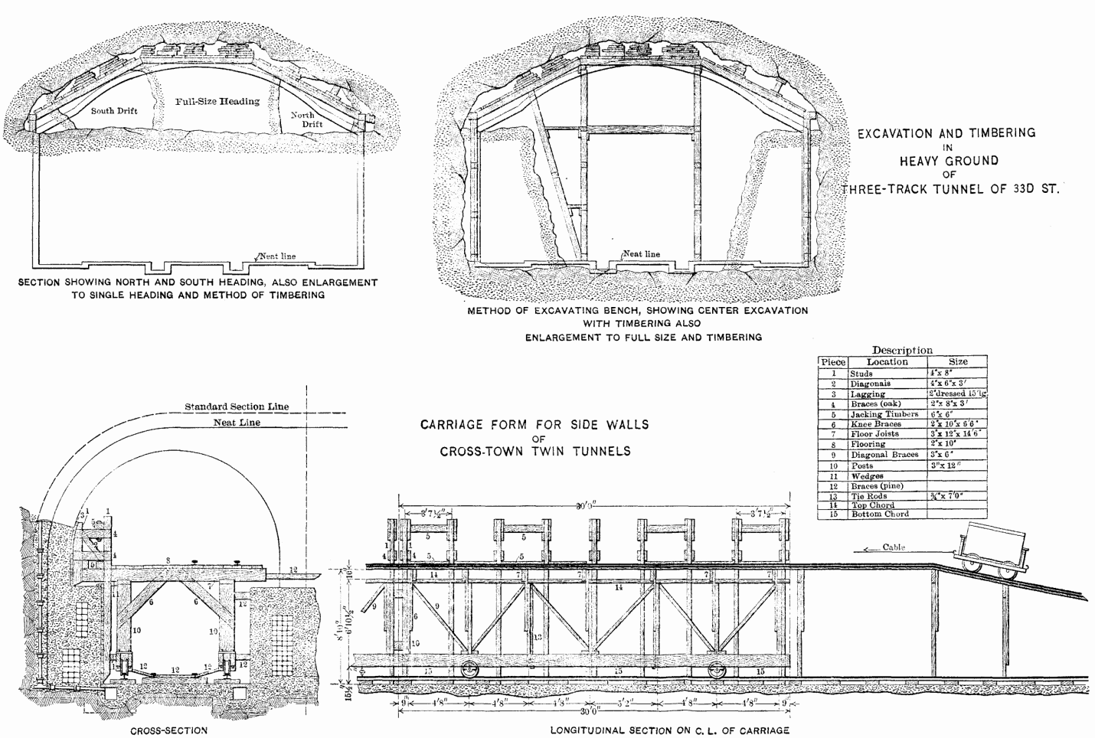
Timber Lining

Slide 23
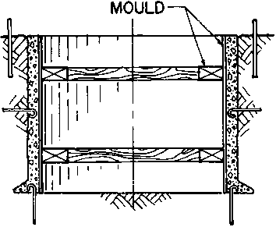
4.Monolithic Concrete lining: –

Slide 24
Advantages of Monolithic Concrete lining:-
Complete mechanization possible.
Good bond between lining and shaft.
Decreased labour cost.
High strength.

Slide 25
Disadvantages of Monolithic Concrete lining :-
Less resistance to corrosive water
Sensitivity to rock mass movement
Inability to take load immediately
Difficult to repairs

Slide 26
Some Important facts :-
17-25Mpa is sufficient.
Minimum thickness of lining is 200mm.
Maximum thickness of lining is 800 mm.
Collapsible steel forms /segment with seam
Sliding type – longer segments

Slide 27
5.Shotcrete lining:-
Composition:-
Shotcrete
Shotcrete + rock bolts +mesh
RCC
RCC +bolts (temp. supports)
Applicable in dry shafts
Very good bonding
High strength due to low water

Slide 28
{ t=r₀-r_{i ,} r = r₀-r_{i} }
σ_{t(max)}/F.S = 2P₀(t+r_{i})²/t(t+2r_{i})
P₀ = r h ( tan ^{r}(π/4-φ/2))
Φ = angle of internal friction
σ_{t} = (P₀r₀²/(r₀²-r_{i}²))((1+r_{i}²)/r₀²)
= 2P₀r₀²
σ_{t} = (P₀)((r₀=r_{i})²-2r₀r_{i})/(r₀+r_{i})(r₀-r_{i})
=P₀(r₀+r_{i})/(r₀-r_{i})-(2P₀r₀r_{i})/(r₀²-r­_{i}²)

Slide 29
Primary Stresses:-
σ_{r}=∑rh
h=thickness of rock stratum
for 500 σ_{r}/σ_{t}=2to 3
Polyethylene – membrance to prevent corrosive waters.
The following are the three categories
Cohesion less
Cohesive
Rocks

Slide 30
σ_{r} = p₀
σ_{t} = 2p_{0 .} r_{o}² / r₀² - r_{i}²
σ_{t max} / F.S = 2p_{0 .} (t+r_{i})² / (r₀ - r_{i} )( r₀ + r_{i})
= 2p_{0 .} (t+r_{i})² / (t)( r₀ + r_{i})
σ_{t max} / F.S = 2p_{0 .} (t+r_{i})² / (t)( t +2 r_{i})
t = { ( σ_{t max} / F.S )/( σ_{t max} /F.S – 2.p_{o} ) - 1 }
σ_{t max} = 0.67 fcu.
P₀

Slide 31
fcu : Cube strength of concrete after 28 days
(British standard code )
r_{f} : for applied load
r_{m} : different srength in concrete
(due in sufficient copaction & difference in curving ).
r_{m} = 1.5 and r_{f} = 1.4
0.67/1.4 x1.5 = 2x0.01xd(t+r_{i})² / (t)( t +2 r_{i})
.: t =r_{i} [ (0.67fcu/2.1)/(0.67fcu/2.1 – 2x0.01d)} - 1]
d in mts , r_{i} in mts , t in mm and fcu in N/mm²

Slide 32
Some Points :-
Support of Shaft equipment and walls .
Shallow square (timber support).
Deep circular or spherical.
Concrete lining mostly – mechanized/utilizes the structure features of concrete, easy least air flow resistance.
Strengths 20 to 50 Mpa .
Cast iron tubbings with concrete mantle welded steel lining (water heads).

Slide 33
Bitumen envelop for preventing damage due to subsiding strata.
Temporary support fos = 1.
Permanent fos > 1 (lining conditions and life space ).
Primary stress σ _{v} = Σ γ h.
σ _{h} /σ _{v} = 2 to 3 < 500m depth .
σ_{h­} = σ_{v} . K_{a} K_{a} : co efficient of active stress.
Stress distribution around shaft existing cracks , shaft diameter ,method of (D and B or boring ),time of exposure without support type of temp. Support used and delay instead of permanent lining .

Slide 34
σ_{h­} = σ_{v} . K_{a} K_{a} : co efficient of active stress.
Polyethylene membrane for preventing corrosion of concrete for water insulation.
RMR and Q → K_{a­} ( Horizontal design stress).
Un supported span ( 15 – 25 m).
Thank You

